Slide 1
Bacteria’s Pathing Simulation
Aram Leblebjian – Joseph Alakach

Slide 2
TABLE OF CONTENTS
Background Information
Problem Formulation
01
02
Methodologies
Results & Analysis
03
04
Bacteria’s Run and tumble motion, Reinforcement Learning, Q-Learning.
Explanation of the problem and its rules.
Bacteria’s pathing simulation through different AI techniques.
Comparison between different models, Importance of the findings, and Future work.

Slide 3
Background Information
01
Bacteria’s Run and tumble motion, Reinforcement Learning, Q-Learning.

Slide 4
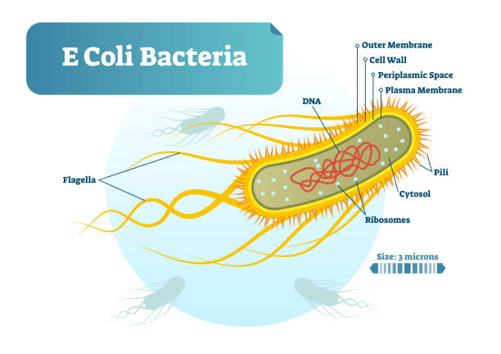
Bacteria’s Run & Tumble Motion
E coli in motion by Howard C. Berg
The motion of Escherichia coli (E. coli) bacteria.
A unique ability to move in a directed manner, known as bacterial chemotaxis.

Slide 5
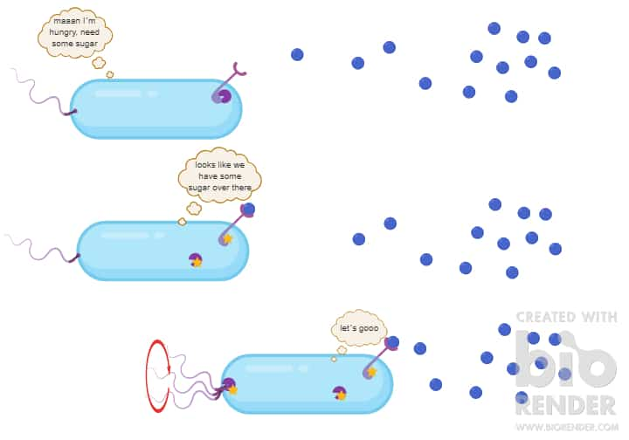
Bacteria’s Run & Tumble Motion
Chemotaxis allows bacteria to sense and respond to changes in their environment.
Navigate toward favorable conditions or move away from harmful substances.
Crucial in bacterial survival and colonization.

Slide 6
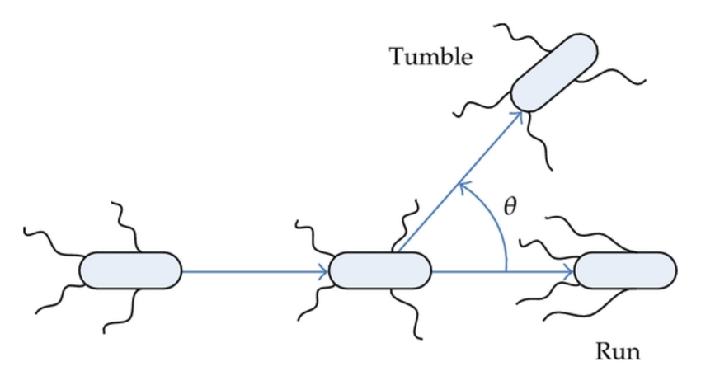
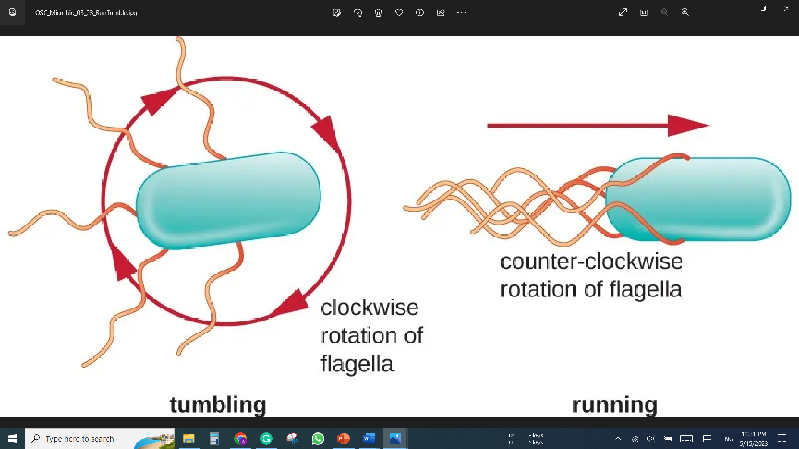
Bacteria’s Run & Tumble Motion
“Run & Tumble" of E. coli Bacteria as they perform chemotaxis.
During a "run" phase, E. coli swims in a relatively straight line.
During tumbling, the bacterium changes its direction randomly.
Random tumbling and directional run allows for an effective exploration strategy in complex environments.

Slide 7
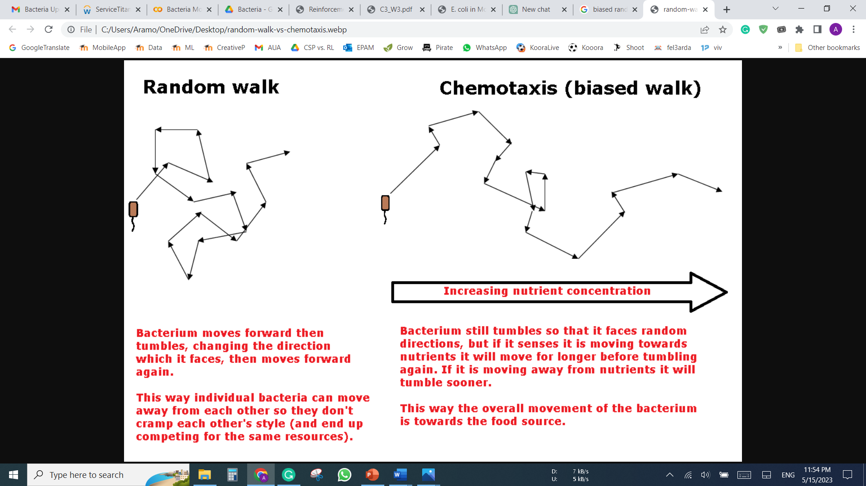
Bacteria’s Run & Tumble Motion
The movement pattern exhibited by bacteria as they navigate their environment in search of favorable conditions.
Elements of randomness (random walk) with a bias or preference towards certain directions based on environmental cues.
The biased random walk enables bacteria to perform an effective search strategy.

Slide 8
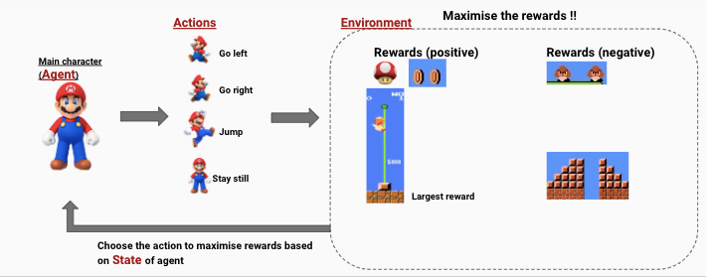
Reinforcement Learning
training agents to learn to make decisions based on feedback from their environment.
Learn a policy that maximizes the expected cumulative reward over time.

Slide 9
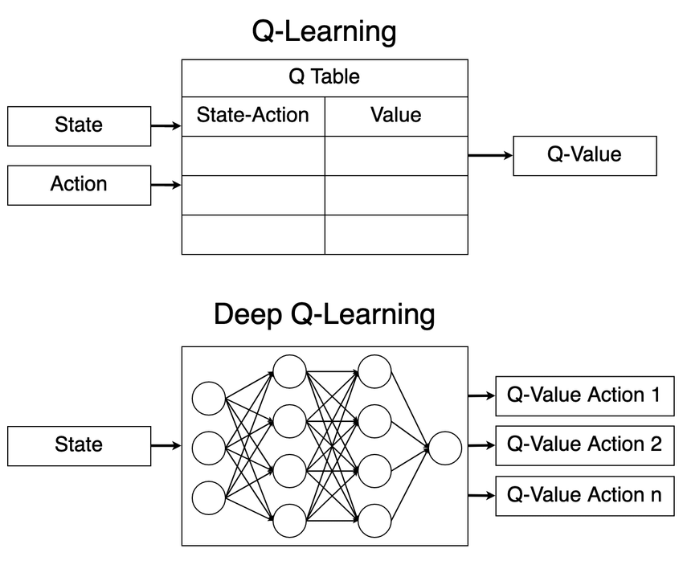
Q-Learning & Deep Q-Learning
Q-learning learns the optimal policy for a given problem through trial and error.
Useful in problems with discrete action and state spaces, with limited possible actions and states.
Deep Q-learning uses deep neural networks to estimate the Q-values of state-action pairs.
effective for problems with large state spaces, where a high-dimensional image represents the state.

Slide 10
Problem Formulation
02
Explanation of the problem and its rules.

Slide 11
Problem Formulation
Bacteria are 2 μm long and 0.5 μm and represented as a point in a cartesian plane (or a cell in 2D array).
They move with a mean speed of ~ 20 μm/s. (0.2 μm between each cell)
They can move in straight lines (runs), which takes 0.01s moving from one cell to another.
They can change direction (tumbles), spending an average of 0.1 s on that.
Food sources are uniformly randomly distributed in a 2D space with a predefined number density.
Each food source produces a normally distributed static “smell” where the mean will be the position of the food and the variances will be … distributed.
Bacteria will eat food instantly, so no time is spent on eating the food.
Bacteria try to eat as much food as possible in the shortest amount of time. If they do not feed for some extended period of time, they will die, as they will lose the energy.

Slide 12
Methodologies
03
Bacteria’s pathing simulation through different AI techniques.

Slide 13
METHODS
Reinforcement Learning
Logical AI
Random Actions
Greedy Smell Model / Manhattan

Slide 14
Reinforcement learning with DQN
We used Deep Q-Network, as the state space of the problem is relatively very big.
After several attempts and tests with different layers we found that using a simple 2 Dense fully connected layers are enough to generate our desired Q-Values.

Slide 15
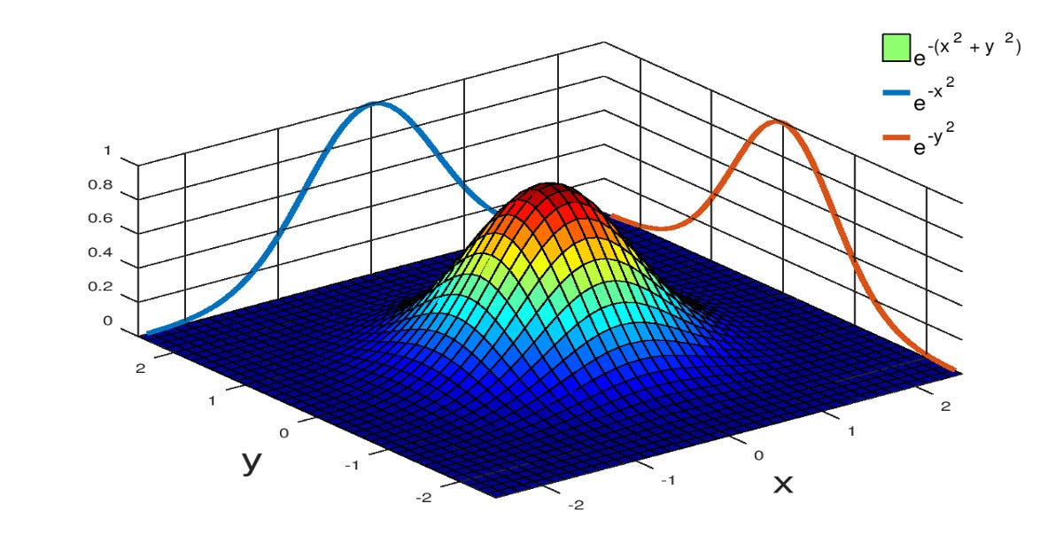
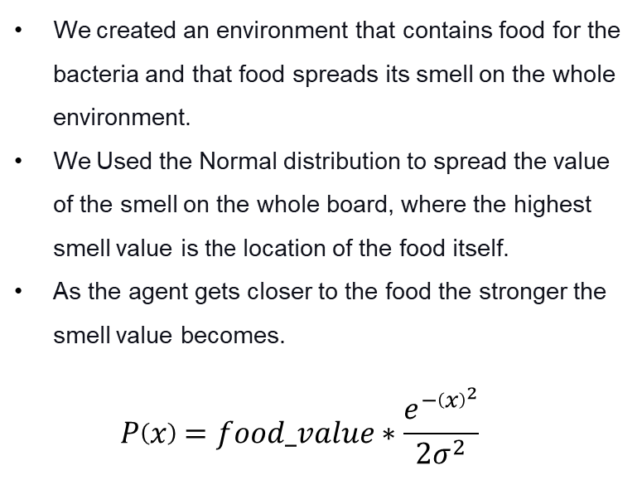
Bacteria Environment
We created an environment that contains food for the bacteria and that food spreads its smell on the whole environment.
We Used the Normal distribution to spread the value of the smell on the whole board, where the highest smell value is the location of the food itself.
As the agent gets closer to the food the stronger the smell value becomes. $P\left(x\right)=food_value∗\frac{e^{−{\left(x\right)}^{2}}}{{2σ}^{2}}$

Slide 16
RL Agent
Our agent is the bacteria that is located in the environment with the food. The agent can sense the smell of the food and can move to get closer to the food
Our agent’s sense of smell picks up the smell values in a 3 by 3 square to simulate small smell radius. Thus, our agent’s input (observation) is a 3 by 3 matrix
Based on the smell matrix that our agent picked up, it uses the NN to determine which direction it would go
The agent can Move 8 different directions. Thus, the action space of our model is 8 different directions
B
F

Slide 17
RL Agent
For our reward system is based on the smell value on the environment
When the bacteria moves from location A to location B the reward of this action will the smell value difference between A and B. Thus, if the bacteria moves to higher smell value it get positive reward and negative on the other case.
Eating the food results in a positive 200 as a reward and eating every food is +1000 which is win
If the bacteria wares out its time without eating every food, it dies and gets a -1000 as reward
B
F

Slide 18
Greedy model
Can sense the smell of the food that surrounds it and chooses to move to the cell with the highest smell.
55
35
60
100
40

Slide 19
Random actions
Takes a random action, until it reaches and eats a food, or dies.
55
35
60
100
40

Slide 20
Logical AI
Takes a random action, if the reward at the new point is greater than it was, it continues taking that action, else goes back and chooses another action.
55
35
60
100
40

Slide 21
Results & Analysis
04
Comparison between different models, Importance of the findings, and Future work.

Slide 22

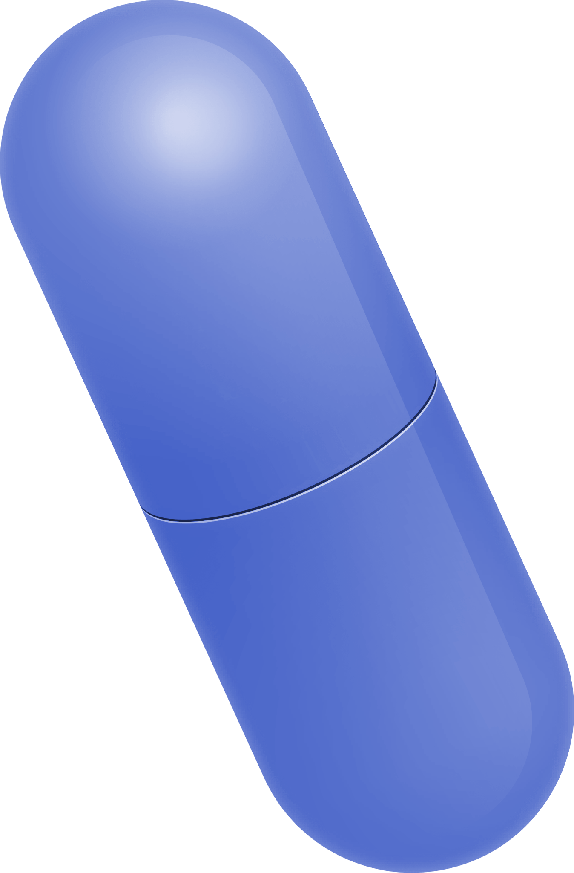
Win Rates for 1 food
RL
Logic
Greedy
Random
100%
100%
100%
28%

Slide 23
Win Rates for 3 foods
RL
Logic
Greedy
Random
83%
100%
78%
6%

Slide 24
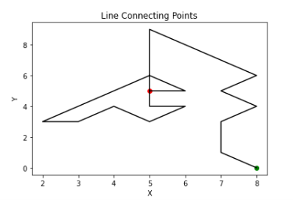
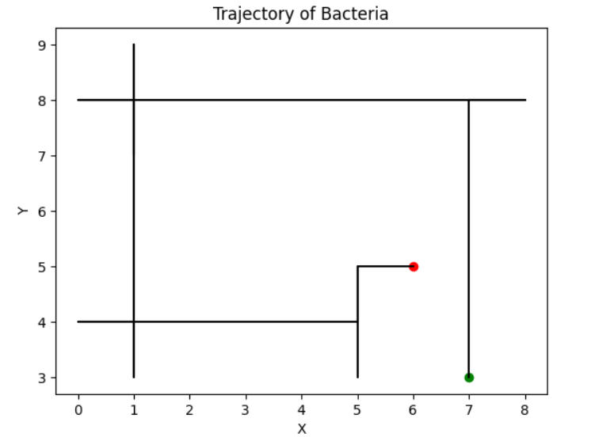
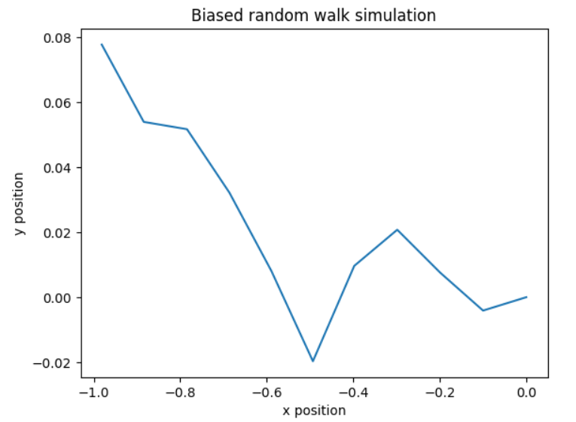
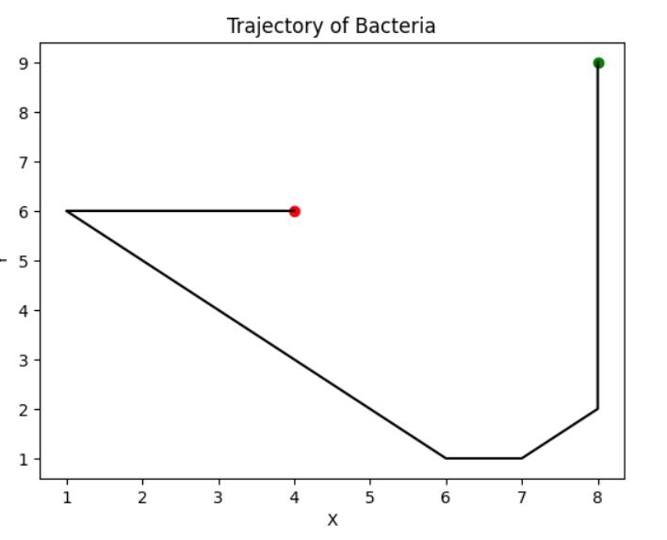
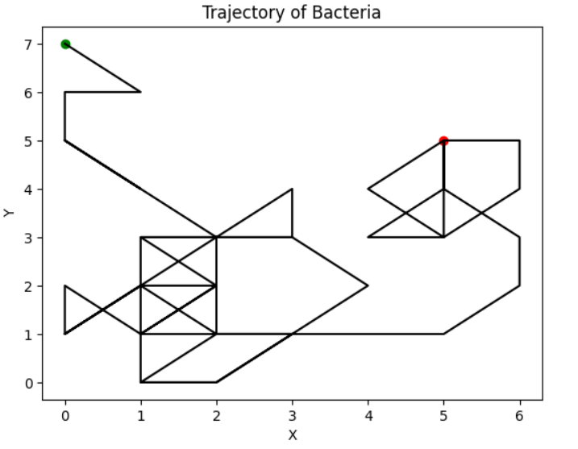
Trajectories
Logic
RL
Random
Greedy

Slide 25
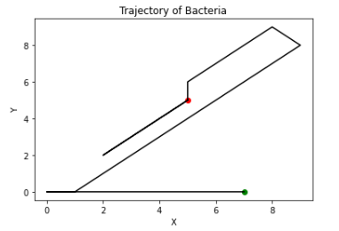
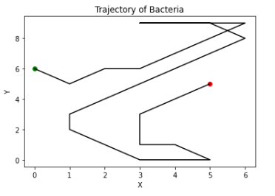
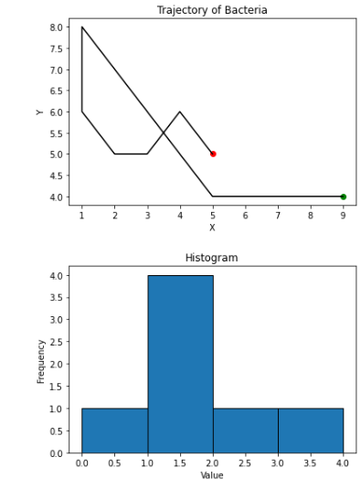
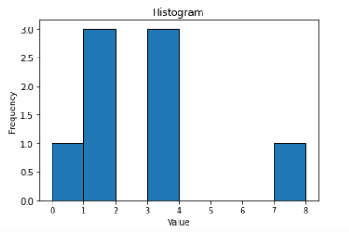
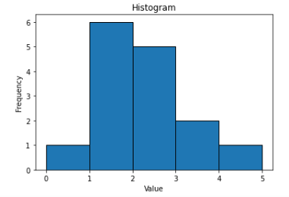
RL Trajectories with their histograms of consecutive Runs

Slide 26
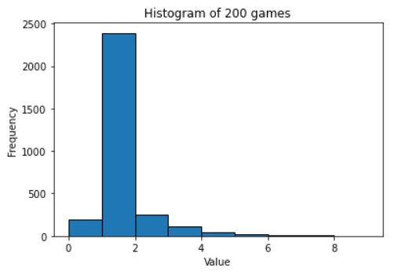
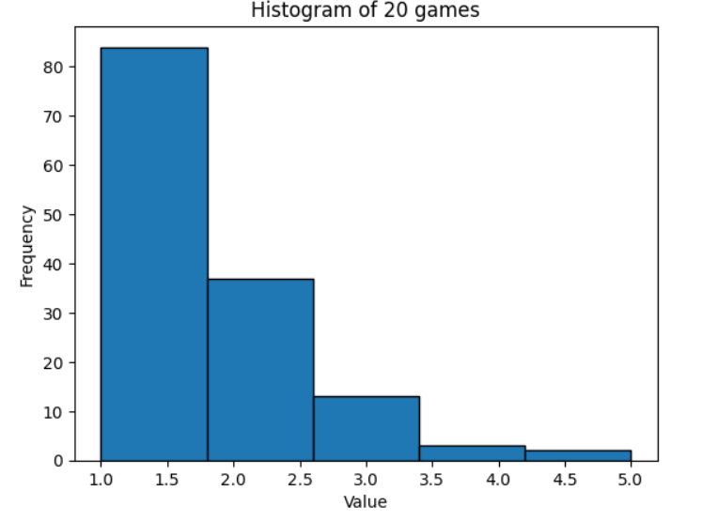
Histograms of consecutive runs before a tumble
RL
Logic

Slide 27
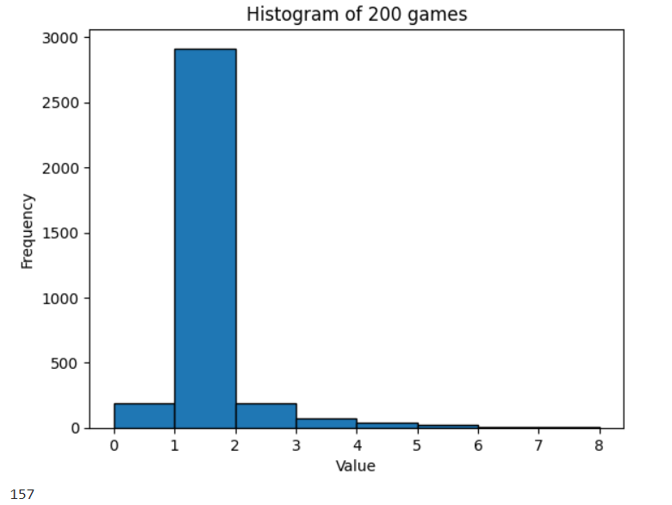
Histograms of consecutive runs before a tumble
RL
Greedy

Slide 28
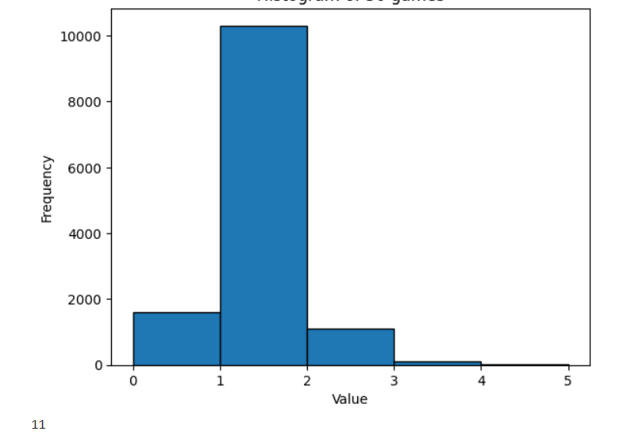
Histograms of consecutive runs before a tumble
Random
RL

Slide 29
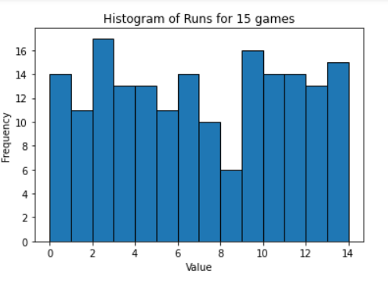
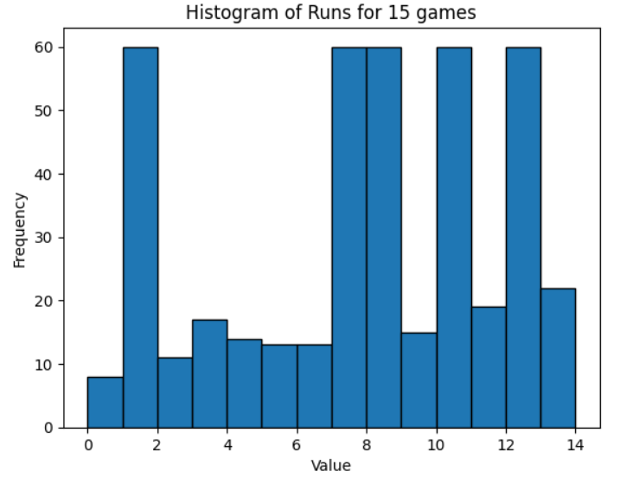
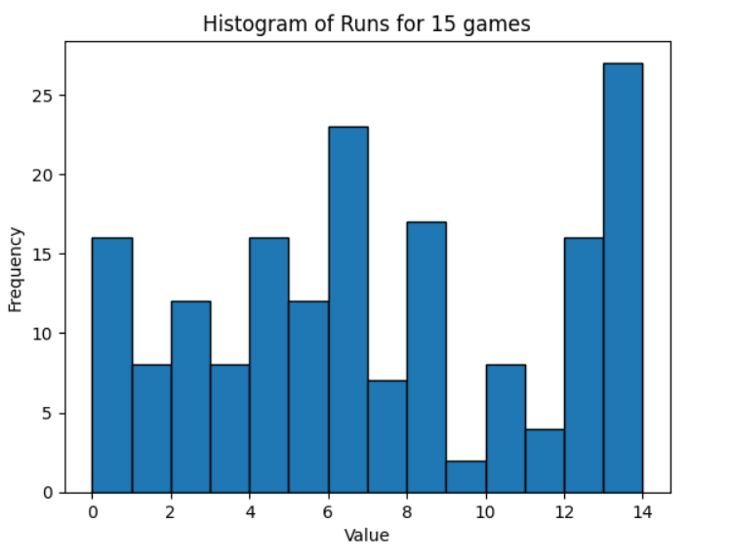
Histograms of sum of runs
RL
Greedy
Logic

Slide 30
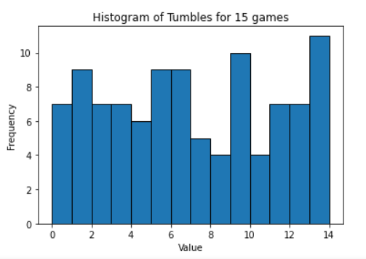
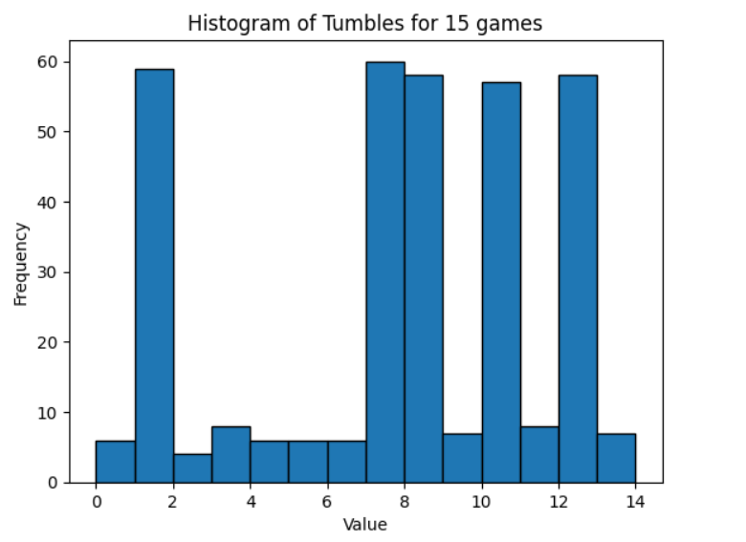
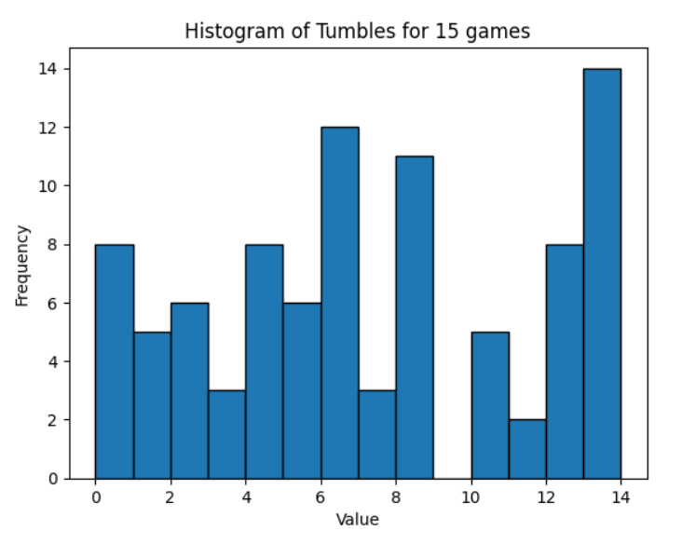
Histograms of sum of tumbles
RL
Greedy
Logic

Slide 31
Future Work
Increase the game's complexity, where food will be generated in random time intervals.
Add more bacteria to the board and train.

Slide 32
Importance of the Research
Develop new reinforcement learning models and algorithms.
Understand how to enhance the decision-making process in AI systems.
Uncover new and novel approaches to optimization and problem-solving by studying pathing strategies of bacteria.
Understand the strategies bacteria employ to find nutrients so that we can potentially develop targeted delivery mechanisms for antimicrobial agents or develop more effective methods for combating bacterial infections.
Identify specific targets or pathways that could be exploited for drug intervention by studying how bacteria respond to different stimuli and navigate toward nutrients.
Use the knowledge to help in designing drugs that disrupt the chemotaxis of bacteria, impairing their ability to reach and utilize nutrients, thereby inhibiting their growth and survival.

Slide 33
Thanks! Any Questions?

